Slide 1
Mobile Application Development
Lecture 11

Slide 2
Using a Shared Module
Angular provides us with resusability. But how does it works?
What if we write a piece of code and we want to use it in many different pages?
In Angular, we have the concept of Shared Module
Notes:
First of all, we need to understand what Parent, Child, and Sibling components are.

Slide 3
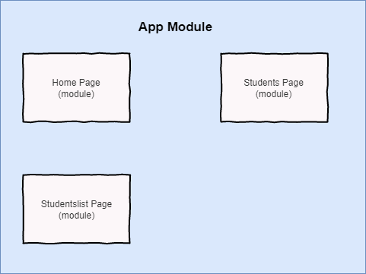
Using a Shared Module
This is what our structure looks like.
We have 3 modules inside main App Module.
what if we want something that will be used in all three modules?
Notes:
First of all, we need to understand what Parent, Child, and Sibling components are.

Slide 4
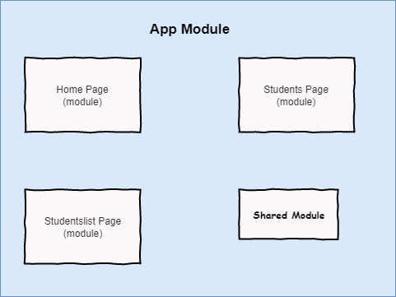
Using a Shared Module
We create a Shared Module.
How will this work? This Shared Module will be accessible in any other module that we want.
Notes:
First of all, we need to understand what Parent, Child, and Sibling components are.

Slide 5
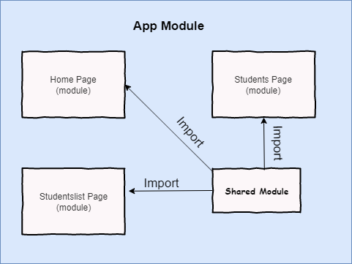
Using a Shared Module
But how will it be accessible in other modules? By Importing it in Imports.
Notes:
First of all, we need to understand what Parent, Child, and Sibling components are.

Slide 6

You know successful people aren’t necessarily more intelligent or more talented than anyone else. But their habits take them in the direction of becoming more informed, more knowledgeable, more competent, better skilled, and better prepared.

Slide 7
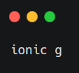
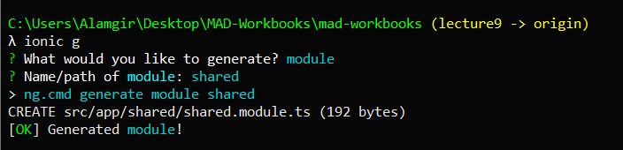
Using a Shared Module
Lets create a Shared Module.
Notes:
First of all, we need to understand what Parent, Child, and Sibling components are.

Slide 8
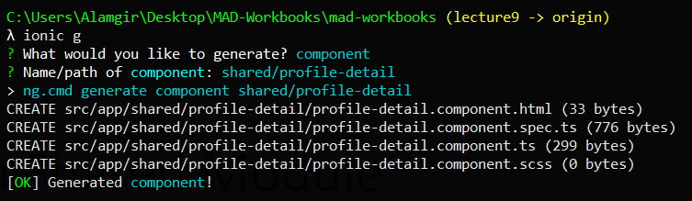
Using a Shared Module
Our Shared Module has been created. It’s empty however. Lets add a component which we will use in different modules. Right now, we are displaying profile for students, we also have to display profile for teachers. So let create profile-detail component inside shared.
Notes:
First of all, we need to understand what Parent, Child, and Sibling components are.

Slide 9
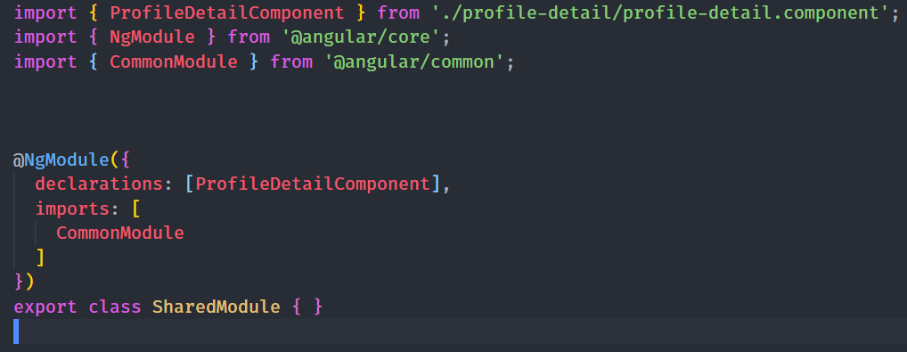
Using a Shared Module
We have created a component but haven’t declared it in any module.
Lets add it to declaration of shared.module.ts
Notes:
First of all, we need to understand what Parent, Child, and Sibling components are.

Slide 10
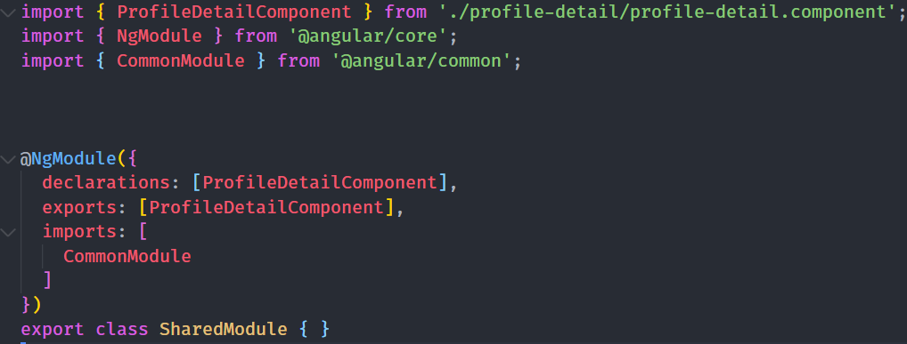
Using a Shared Module
Now in order to use profile-detail component in Students.component.ts, we need to add it to Exports in the module as well.
These exports components will be available only.
Notes:
First of all, we need to understand what Parent, Child, and Sibling components are.

Slide 11
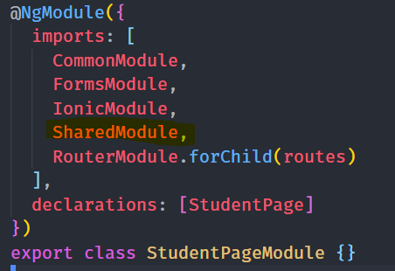
Using a Shared Module
Now we import Shared Module inside students.module.ts
Notes:
First of all, we need to understand what Parent, Child, and Sibling components are.

Slide 12
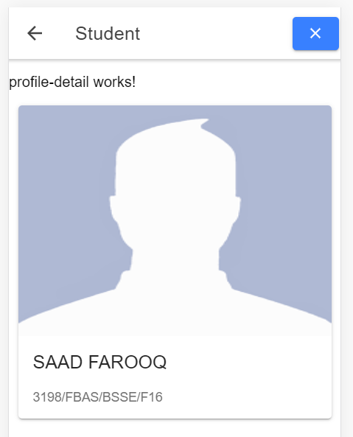
Using a Shared Module
Now if we display <app-profile-detail> </app-profile-detail> inside the html of students.component.html, it will work.
But it will give an error in studentslist.component.html because it is not imported in that module.
Notes:
First of all, we need to understand what Parent, Child, and Sibling components are.

Slide 13
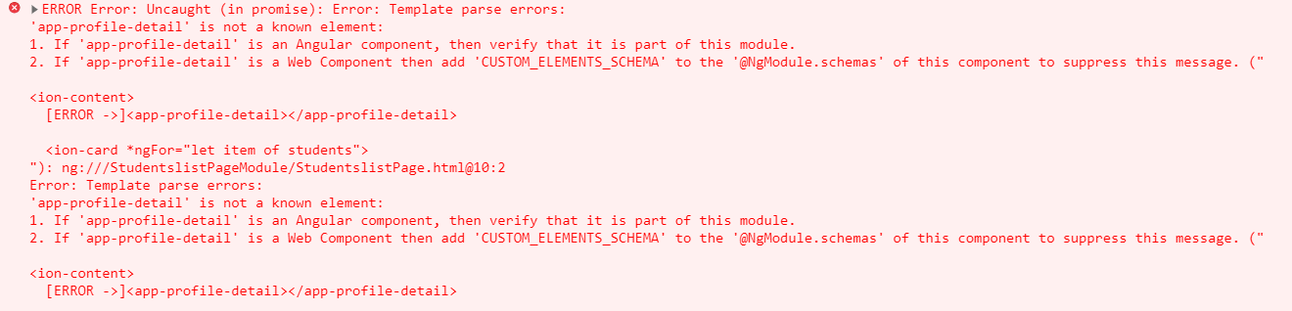
Using a Shared Module
We would get this error. We can resolve this by importing shared module in studentslist.module.ts
Notes:
First of all, we need to understand what Parent, Child, and Sibling components are.

